Slide 1
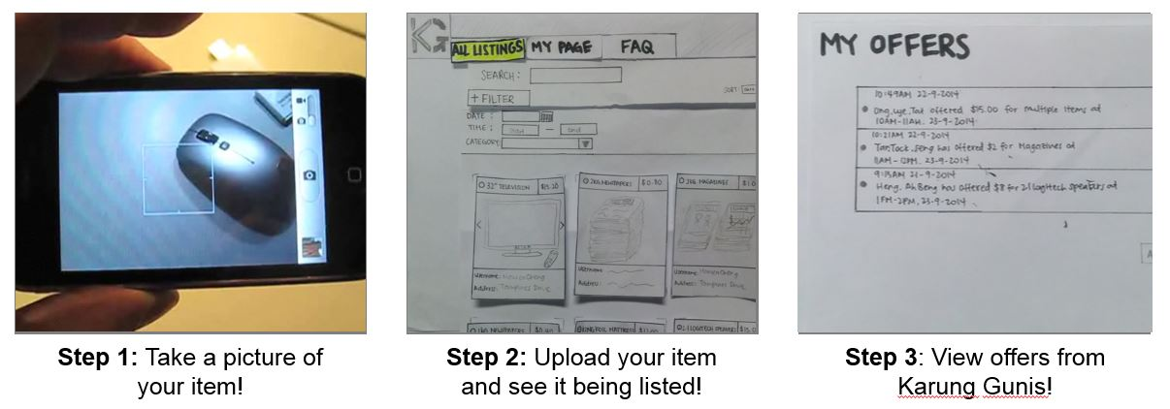
Karung Guni Application
Buy & Sell your recyclable items now!
In 3 simple easy steps:

Slide 2
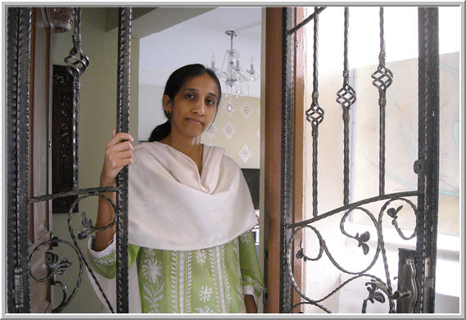
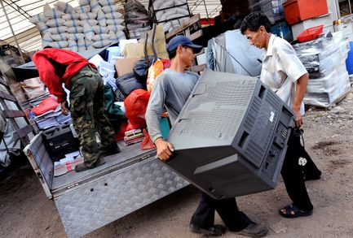
Choose a user type
Seller
Buyer

Slide 3
REGISTER - SELLER
Please select your preferred timings
Username/E-mail:
M | T | W | T | F | S | S
Password:
9AM – 12PM
Confirm Password:
12PM – 3PM
Name:
3PM – 6PM
Contact:
6PM – 9PM
Address: Blk
Unit:
Road:
Submit
Cancel
Postal Code:

Slide 4
REGISTER - SELLER
Username/E-mail:
Password:
Confirm Password:
Name:
Contact:
Address: Blk
Unit:
Road:
Submit
Cancel
Postal Code:

Slide 5
EDIT PROFILE
Please select your preferred timings
Username/E-mail:
MonicaCheng@hotmail.com
M | T | W | T | F | S | S
Password:
********
9AM – 12PM
Confirm Password:
********
12PM – 3PM
Name:
Monica Cheng
3PM – 6PM
Contact:
96969696
6PM – 9PM
Address: Blk
85
Unit:
#10-237
Road:
Bedok Ave 5
Update
Cancel
Postal Code:
520085

Slide 6
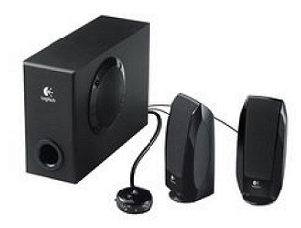

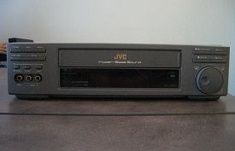
All Listings
List of Items
Search:
------
Sort by:
------
Category:
ALL
Seller Availability
Date:
------
Time:
------
------
2.1 LOGITECH SPEAKERS Category: Electronics Condition: 8 Price: $ 34.50 Description: Item is in great shape Seller: MonicaCheng@hotmail.com
OLD NEWSPAPERS Category: Newspapers/Cardboards Condition: 10 Price: $7.00 Description: Straits Times, Newpaper from the past 3 months. Weight is close to 15kg Seller: MonicaCheng@hotmail.com
SPOILT VCR Category: Electronics Condition: 2 Price: $5.00 Description: VCR is over 10 years old & is no longer usable. However, parts are still intact. Seller: uncleDesmond@conman.com
2.1 LOGITECH SPEAKERS
Category | Electronics
Condition | 8/10
Price | $34.50
Description | Item is in great shape
Seller | MonicaCheng@hotmail.com
OLD NEWSPAPERS
Category | Newspapers/Cardboards
Condition | 10/10
Price | $7.00
Description | Straits Times, Newpaper from the past 3 months. Weight is close to 15kg
Seller | MonicaCheng@hotmail.com
SPOILT VCR
Category | Electronics
Condition | 2/10
Price | $5.00
Description | VCR is over 10 years old & is no longer usable. However, parts are still intact
Seller | uncleDesmond@conman.com

Slide 7
ADD ITEM
Status:
Available
Item Name:
Category:
Condition:
/10
Details:
Add Pictures!
Price: $
ADD
CANCEL

Slide 8
EDIT ITEM
Status:
Available
Item Name:
2.1 LOGITECH SPEAKERS
Category:
Electronics
Condition:
8
/10
Details:
Item is in great shape
Price: $
34.50
UPDATE
CHANGE STATUS
DELETE ITEM

Slide 9


Ong Lye Tat has sent you an offer for 2 items
Mary Tan has sent you an offer

Slide 10
REGISTER - SELLER
10.89AM – 22-9-2014 Ong Lye Tat has offered $50 for 2.1 LOGITECH SPEAKERS & OLD NEWSPAPERS
10.89AM – 22-9-2014 Mary Tan has offered $30 for 2.1 LOGITECH SPEAKERS & OLD NEWSPAPERS
10.89AM – 22-9-2014 Heng ah Sio has offered $40 for 2.1 LOGITECH SPEAKERS
ACCEPT
DECLINE
ACCEPT
DECLINE
ACCEPT
DECLINE

Slide 11



BUYER’S PROFILE
Buyer’s Name
Ong Lye Tat
Email:
ongLyeTat@gmail.com
Contact:
97124747
Rating:
4
4
2

Slide 12
My Page
DEALS TODAY
Date
11 Sept 2014
Time
10AM – 11AM
CONTACT: 96969696
SELLER: Monica Cheng
LOCATION: Bedok Blk 85 - #10-237
2.1 LOGITECH SPEAKERS
Condition | 8/10
Price | $34.50
OLD NEWSPAPERS
Condition | 10/10
Price | $7.00

